Slide 1
Restaurant Automation System (RAS)
By
Polavarapu Hemasree(20JE0690)
Porika Rana Prathap(20JE0692)
Priyanshu Raj(20JE0730)
Pulipati Sai Nikhil(20JE0735)

Slide 2
Materials
2 drinking glasses
Table salt
2 Eggs
Water
Found around the house!

Slide 3



Procedure
Requirement Specification
Design
Implementation
Testing

Slide 4
Hypothesis

Slide 5
The RAS will help restaurant owners automate day–to-day activities and mitigate human error.

Slide 6
Functionalities/Screens
Manager Screen
Helps manager navigate through his assigned tasks and authorities.

Slide 7
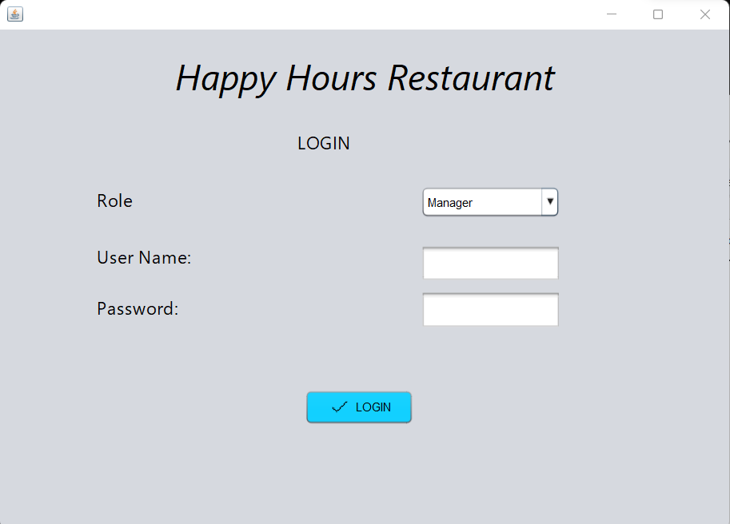
LOGIN PAGE
Every user like owner, manager, chef, sales clerk can login through their own username and password. Unauthorized users such as username or password is incorrect are not allowed to login.

Slide 8
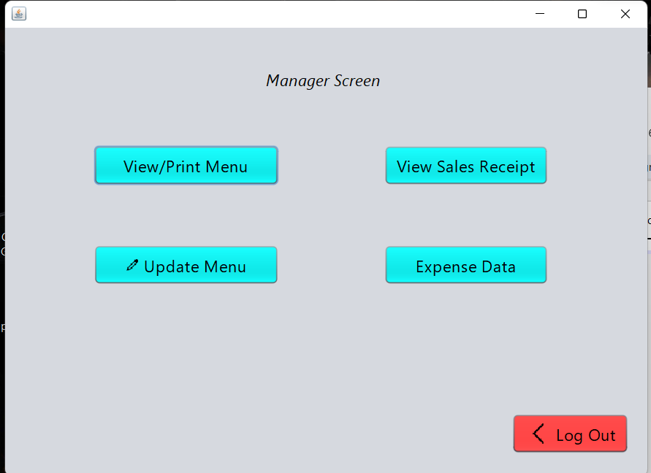
MANAGER PAGE
This is the Manager’s page which appears after a manager has logged in. This contains the functions that are dealt by the Manager such as updating menu, viewing sales receipt and others.

Slide 9
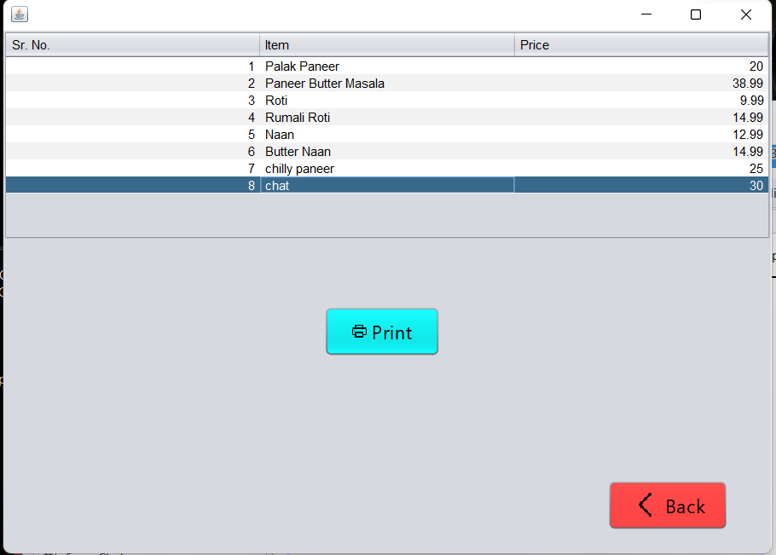
MENU PAGE
This is the menu page that is appeared after the manager click the view/print menu option. This displays all the items present at the restaurant with their respective price.

Slide 10
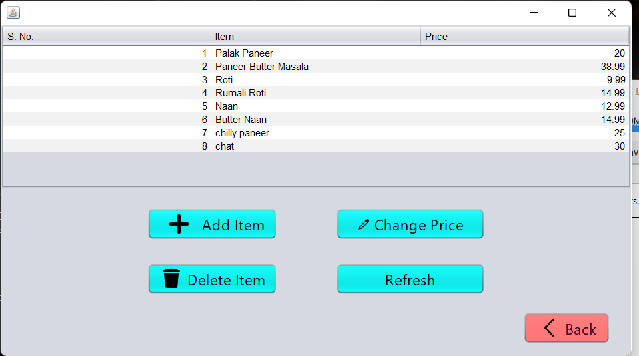
EDIT MENU PAGE
Manager can add a new item or delete an existing item or change the price of an item through this option.

Slide 11
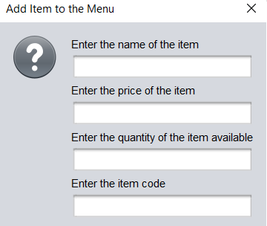
ADD AN ITEM
This is how the manager adds an item in the menu.

Slide 12
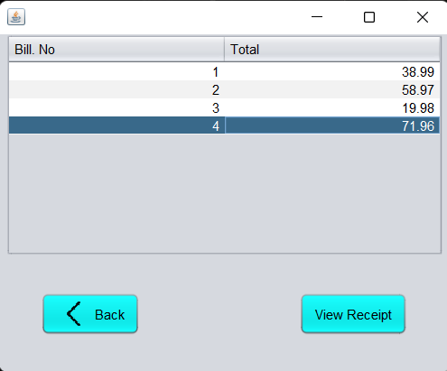
SALES REPORT
This the window for viewing sales report used by the Manager.

Slide 13
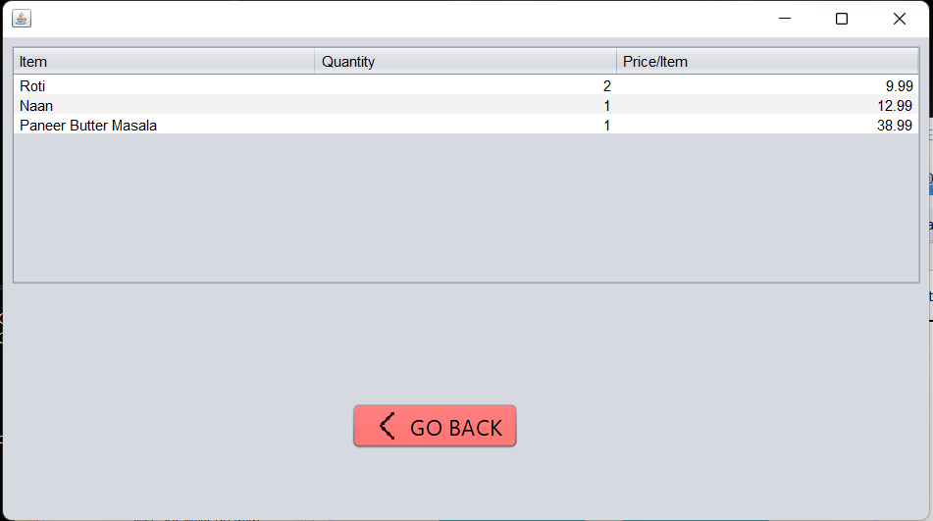
Detailed Sales Receipt
This window shows the amount and price of each item that is purchased.

Slide 14
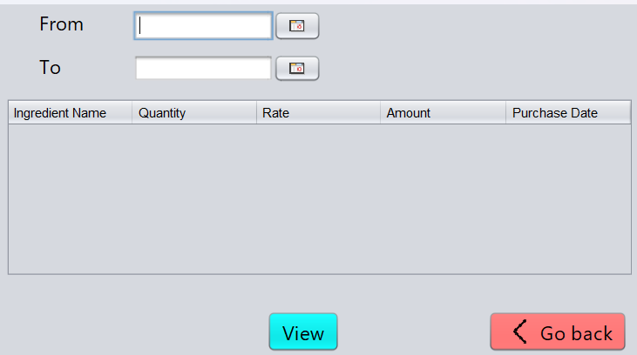
Expense Reports
This shows the quantity of each item that was sold on different days and the total sales of each item.

Slide 15
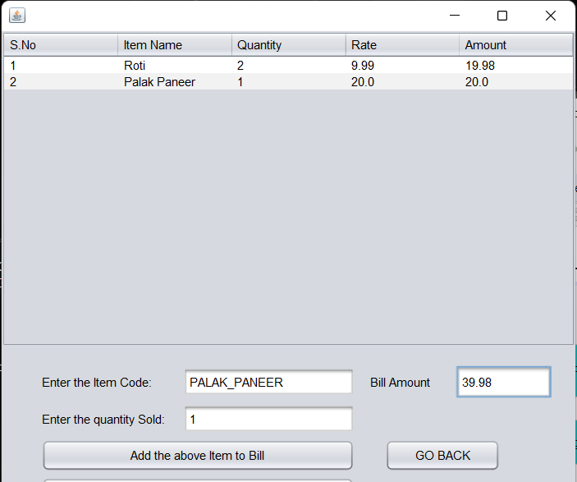
Add Item to bill
This is the where the manager can add an item to the existing bill.

Slide 16
Functionalities/Screens
Clerk Screen
Helps the clerical staff navigate through their assigned tasks and authorities.

Slide 17
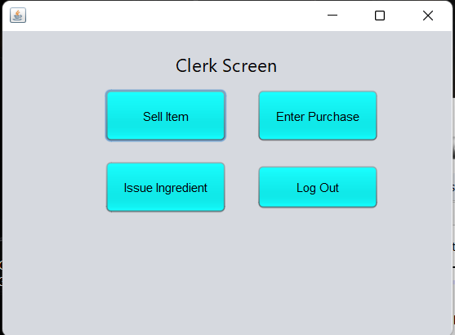
Clerk Screen
This the clerk’s home page after the sales clerk logged in to his account.

Slide 18
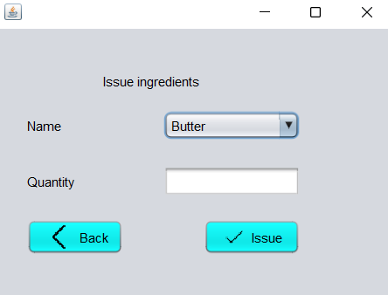
Issue Ingredients
Clerk issues the ingredients that the chef has request for preparing the order through this window.

Slide 19
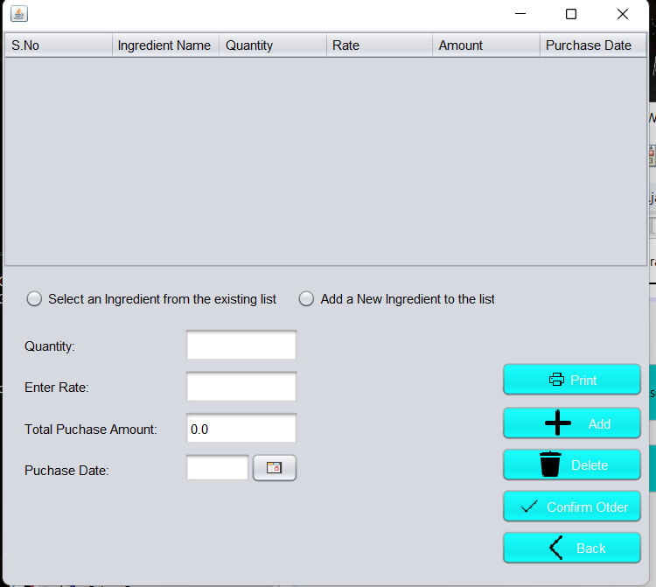
Bill page
This window shows the total bill that includes the items purchased by the customer and amount of each item and price of the items respectively.

